Slide 1
Encapsulation
Encapsulation is one of the four fundamental OOP concepts.
The other three are inheritance, polymorphism, and
abstraction.
Encapsulation in Java is a mechanism of wrapping the data (variables) and code acting on the data (methods) together as a single unit.
In encapsulation, the variables of a class will be hidden from other classes, and can be accessed only through the methods of their current class. Therefore, it is also known as data hiding.
To achieve encapsulation in Java −
Declare the variables of a class as private.
Provide public setter and getter methods to modify and view the variables values.

Slide 2
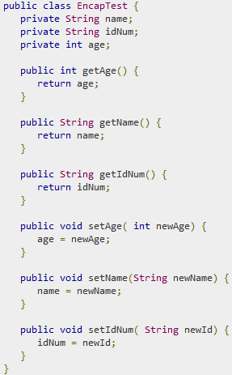

Slide 3
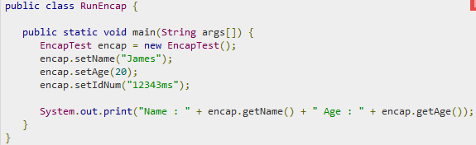


Slide 4
Benefits of Encapsulation
The fields of a class can be made read-only or write- only.
A class can have total control over what is stored in its fields.
The users of a class do not know how the class stores its data. A class can change the data type of a field and users of the class do not need to change any of their code.

Slide 5
Java - Access Modifiers
Java provides a number of access modifiers to set access levels for classes, variables, methods, and constructors. The four access levels are −
Visible to the package, the default. No modifiers are needed.
Visible to the class only (private).
Visible to the world (public).
Visible to the package and all subclasses (protected).

Slide 6
Default Access Modifier - No Keyword
Default access modifier means we do not explicitly
declare an access modifier for a class, field,
method,
A variable or method declared without any access control modifier is available to any other class in the same package.
The fields in an interface are implicitly public static final and the methods in an interface are by default public.

Slide 7

Example: - No Keyword

Slide 8
Private Access Modifier - Private
Methods, variables, and constructors that are declared private can only be accessed within the declared class itself.
Private access modifier is the most restrictive access
level. Class and interfaces cannot be private.
Variables that are declared private can be accessed outside the class, if public getter methods are present in the class.
Using the private modifier is the main way that an object encapsulates itself and hides data from the outside world.

Slide 9
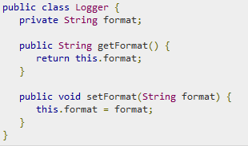
Private Access Modifier - Private

Slide 10
Public Access Modifier - Public
A class, method, constructor, interface, etc. declared public can be accessed from any other class.
Therefore, fields, methods, blocks declared inside a public class can be accessed from any class belonging to the Java Universe.
However, if the public class we are trying to access is in a different package, then the public class still needs to be imported.
Because of class inheritance, all public methods and variables of a class are inherited by its subclasses.

Slide 11

Public Access Modifier - Public
The main() method of an application has to be public.
Otherwise, it could not be called by a Java interpreter (such as java) to run the class.

Slide 12
Protected Access Modifier – Protected
Variables, methods, and constructors, which are declared protected in a super-class can be accessed only by the subclasses in other package or any class within the package of the protected members' class.
The protected access modifier cannot be applied to class and interfaces. Methods, fields can be declared protected, however methods and fields in a interface cannot be declared protected.
Protected access gives the subclass a chance to use the helper method or variable, while preventing a nonrelated class from trying to use it.

Slide 13
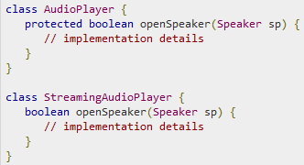
Protected Access Modifier – Protected

Slide 14
Access Control and Inheritance
The following rules for inherited methods are enforced −
Methods declared public in a super-class also must be public in all subclasses.
Methods declared protected in a super-class must
either be protected or public in subclasses; they
cannot be private.
Methods declared private are not inherited at all, so there is no rule for them.

Slide 15

Understanding all java access modifiers

Slide 16
Overloading constructors
Constructor in java is a special type of method that is used to
initialize the object.
Java constructor is invoked at the time of object creation. It constructs the values i.e. provides data for the object that is why it is known as constructor.
Rules for creating java constructor
There are basically two rules defined for the constructor.
Constructor name must be same as its class name
Constructor must have no explicit return type
Types of java constructors
There are two types of constructors:
Default constructor (no-arg constructor)
Parameterized constructor

Slide 17
Default Constructor
A constructor that have no parameter is known as default constructor. Syntax of default constructor:
<class_name>(){}
Example of default constructor
In this example, we are creating the no-arg constructor in the Bike class. It will be invoked at the time of object creation.
class Bike1{
Bike1(){System.out.println("Bike is created");} public static void main(String args[]){
Bike1 b=new Bike1();
}
}

Slide 18
Parameterized constructor
A constructor that have parameters is known as
parameterized constructor.
Why use parameterized constructor?
Parameterized constructor is used to provide different values to the distinct objects.
Constructor Overloading
Constructor overloading is a technique in Java in which a class can have any number of constructors that differ in parameter lists.
The compiler differentiates these constructors by taking into account the number of parameters in the list and their type.

Slide 19
Copy Constructor
There is no copy constructor in java. But, we can copy
the values of one object to another like copy
constructor in C++.
There are many ways to copy the values of one object into another in java. They are:
By constructor
By assigning the values of one object into another
By clone() method of Object class

Slide 20
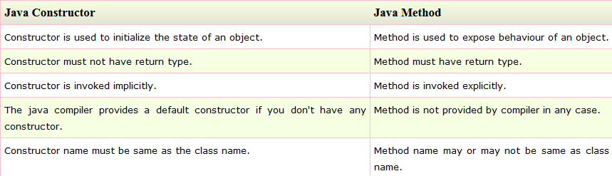

Slide 21
Inheritance
Inheritance in java is a mechanism in which one object acquires all the properties and behaviors of parent object.
The idea behind inheritance in java is that you can create new classes that are built upon existing classes.
When you inherit from an existing class, you can reuse methods and fields of parent class, and you can add new methods and fields also.
Inheritance represents the IS-A relationship, also known as
parent-child relationship.
Why use inheritance in java
For Method Overriding (so runtime polymorphism can be
achieved).
For Code Reusability.

Slide 22
Syntax of Java Inheritance
class Subclass-name extends Superclass-name
{
//methods and fields
}
The extends keyword indicates that you are making a new class that derives from an existing class. The meaning of "extends" is to increase the functionality.
In the terminology of Java, a class which is inherited is called parent or super class and the new class is called child or subclass.

Slide 23
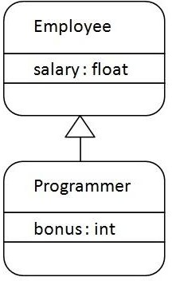
Inheritance Example
Programmer is the subclass and Employee is the superclass.
Relationship between two classes is Programmer IS-A Employee.
It means that Programmer is a type of Employee.

Slide 24
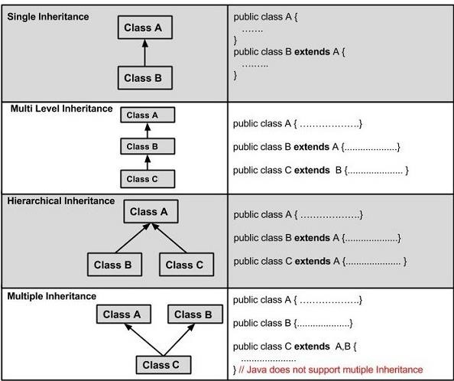

Slide 25
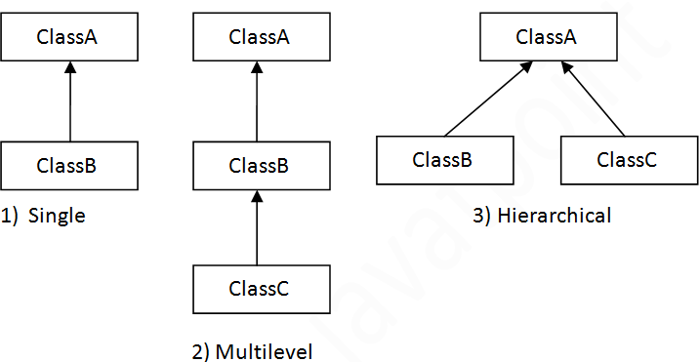
Types of inheritance in java
On the basis of class, there can be three types of inheritance in java: single, multilevel and hierarchical.
In java programming, multiple and hybrid inheritance is supported through interface only.

Slide 26
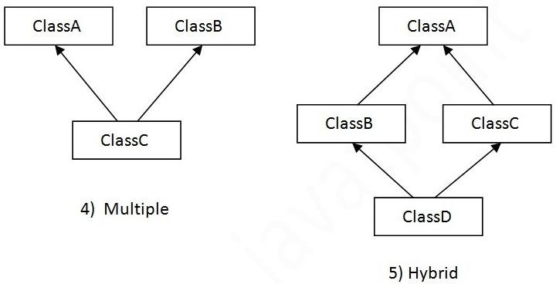
Types of inheritance in java
On the basis of class, there can be three types of inheritance in java: single, multilevel and hierarchical.
In java programming, multiple and hybrid inheritance is supported through interface only.
Note: Multiple inheritance is not supported in java through class.

Slide 27
Why multiple inheritance is not supported in java?
To reduce the complexity and simplify the language, multiple inheritance is not supported in java.
Consider a scenario where A, B and C are three classes. The C class inherits A and B classes. If A and B classes have same method and you call it from child class object, there will be ambiguity to call method of A or B class.
Since compile time errors are better than runtime errors, java renders compile time error if you inherit 2 classes. So whether you have same method or different, there will be compile time error now.

